Slide 1






S25' Training Sessions
mobile app
SESSION 2
#create_share_innovate

Slide 2






Table of contenet
Conditional Statements
Input in Dart
Switch-Case
S25' Training Sessions
Errors
Functions
Loops

Slide 3



Previous Task
S25' Training Sessions
Presentation
15-mins

Slide 4
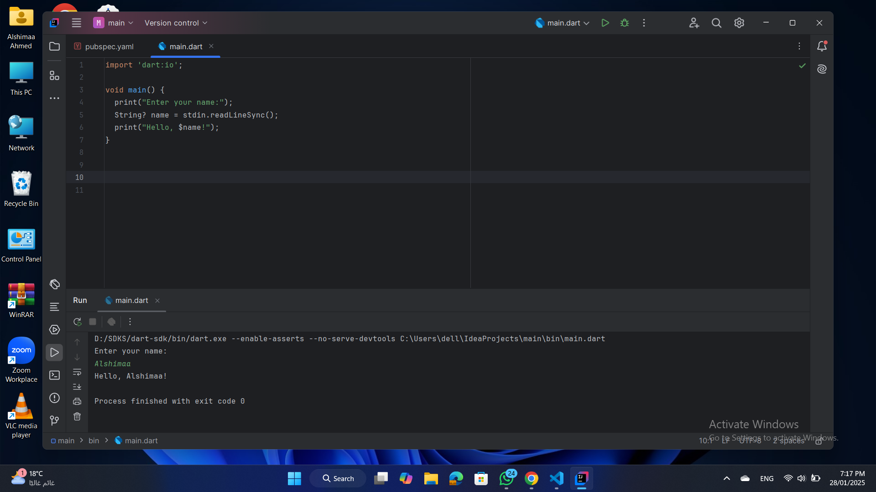
Input in dart
S25' Training Sessions
Using dart:io Package
stdin.readLineSync() :
returns a nullable String?.

Slide 5
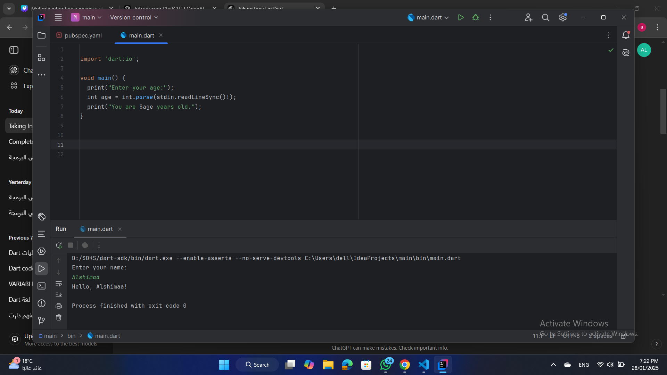
Input in dart
needing parse to convert the input to another type
S25' Training Sessions

Slide 6
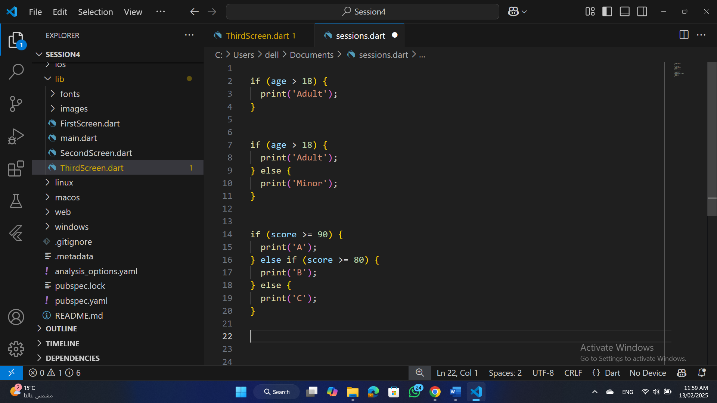
Conditional Statements
if Statement:
Checks a condition and executes code if true.
S25' Training Sessions

Slide 7
Conditional Statements
else Statement:
Executes if the if condition is false.
S25' Training Sessions

Slide 8
Conditional Statements
else if Statement:
Checks multiple conditions
S25' Training Sessions

Slide 9
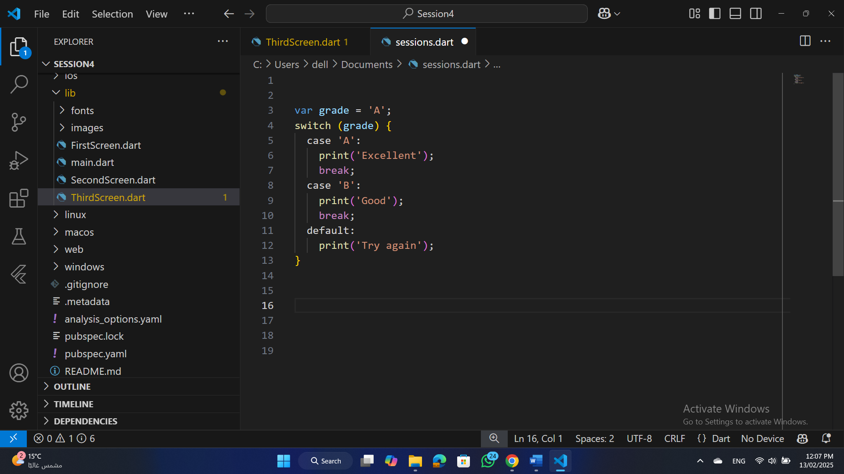
Switch-Case
Efficient for checking a single variable
against multiple values
S25' Training Sessions
Note
break is mandatory to prevent fall-through.
default executes if no cases match.

Slide 10
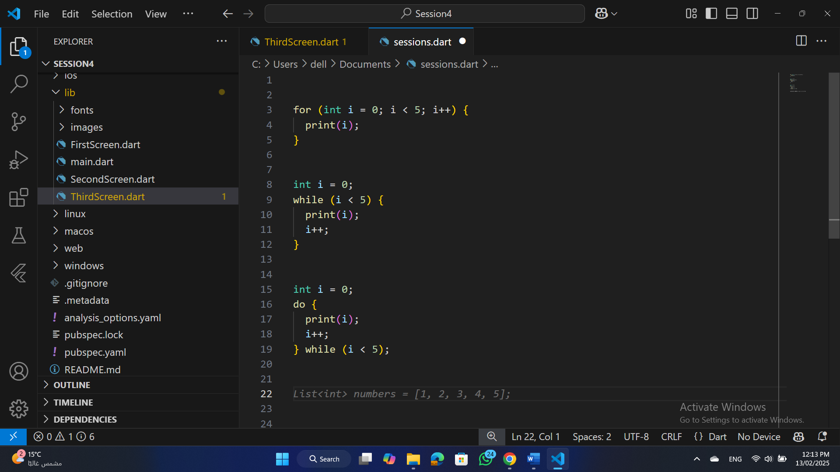
Loops
for Loop:
Runs a fixed number of times.
S25' Training Sessions

Slide 11
Loops
while Loop:
Runs as long as a condition is true.
S25' Training Sessions

Slide 12
Loops
do-while Loop
Executes at least once, then checks the condition.
S25' Training Sessions

Slide 13
Exercise
S25' Training Sessions
Write a program to check whether a number is prime using a for loop .

Slide 14

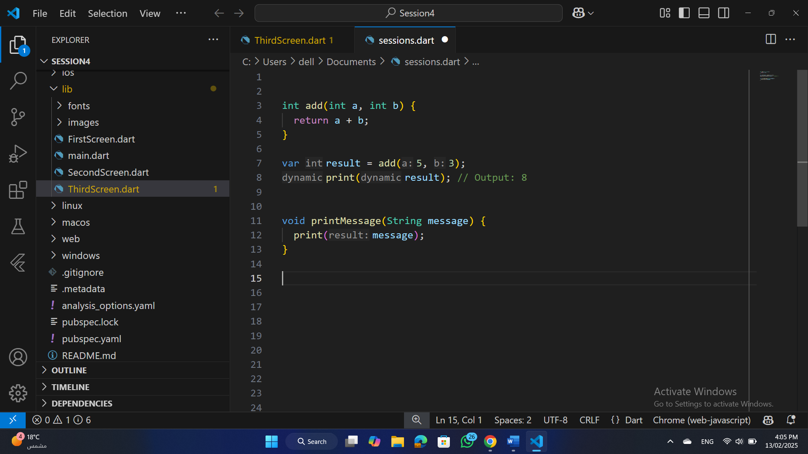
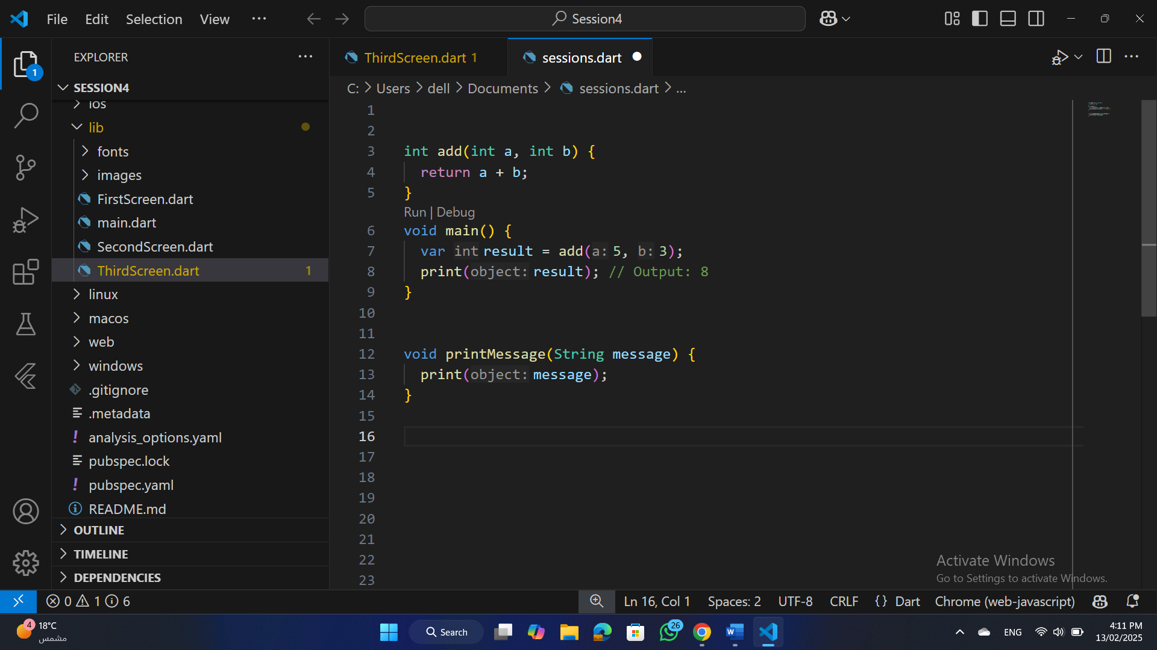
Functions
A function is a block of code that performs a specific task.
S25' Training Sessions
Function Definition :
Function Calling:

Slide 15
Functions
Return Type:
Functions can return values. In the Previous example, the return type is int.
If a function doesn't return a value, use void.
S25' Training Sessions

Slide 16
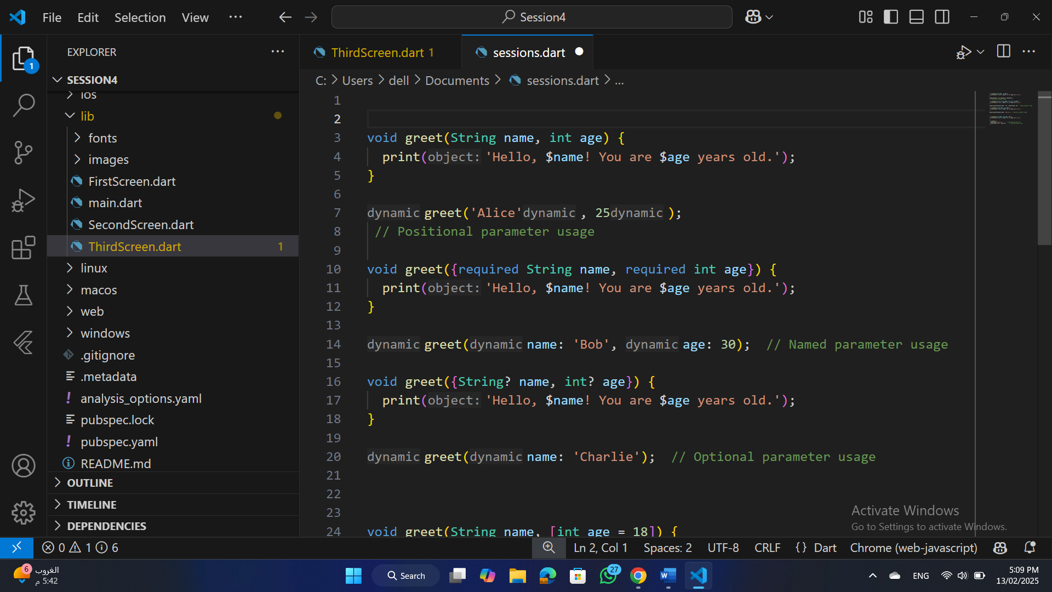
Passing Parameters
Positional Parameters:
Parameters are passed in the order they are defined in the function.
S25' Training Sessions

Slide 17
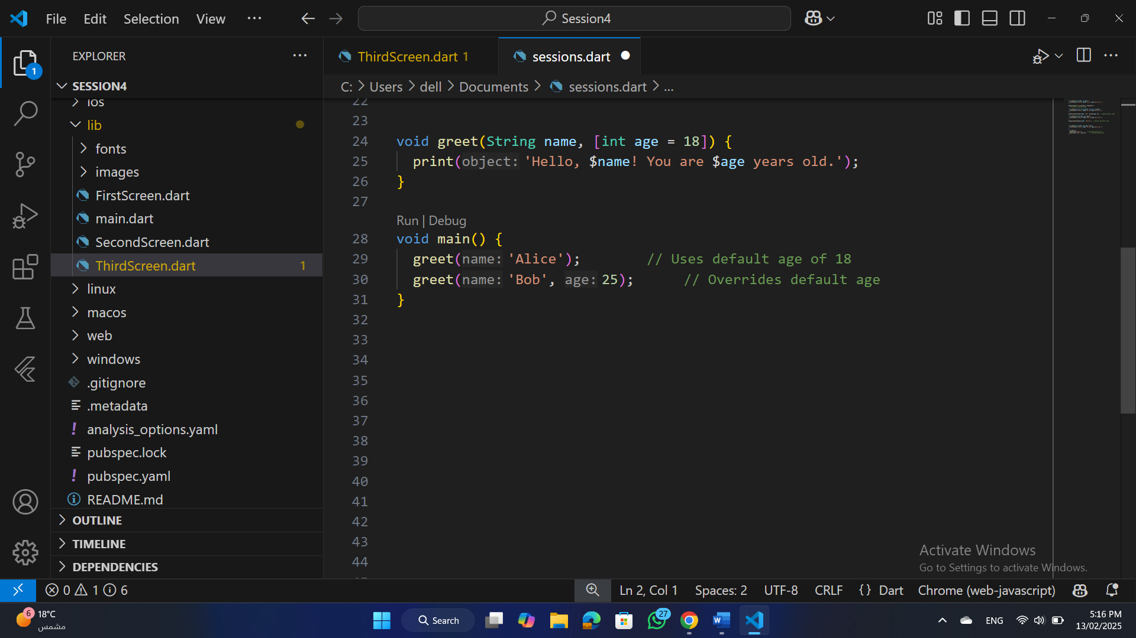
Passing Parameters
Optional Parameters
Parameters can be optional. Use [] for optional parameters.
S25' Training Sessions

Slide 18
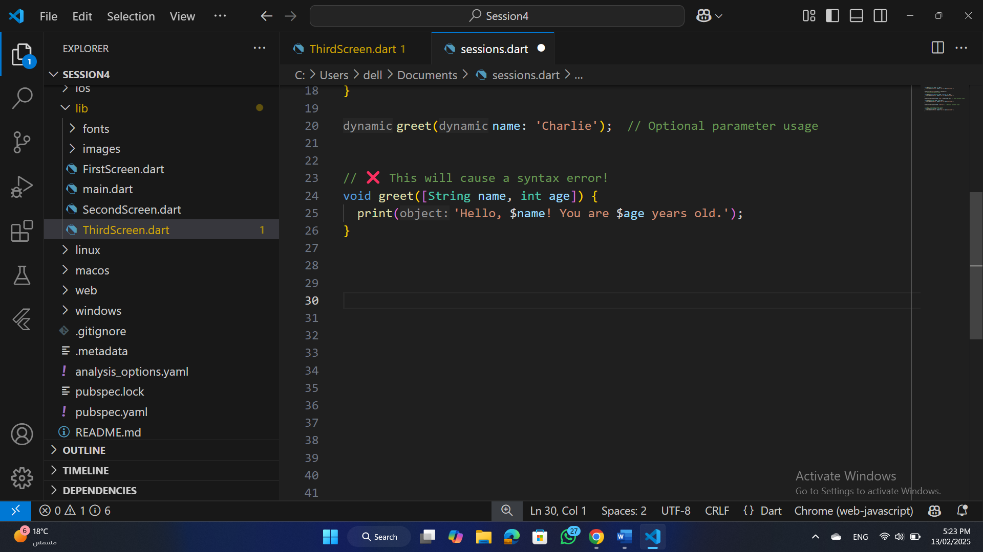
Passing Parameters
:: CAUTION ::
in Dart, positional optional parameters cannot be the first parameter.
S25' Training Sessions

Slide 19
Passing Parameters
Named Required Parameters:
Named parameters allow for more flexible function calls. Use {} to define them.
S25' Training Sessions

Slide 20
Passing Parameters
Named optional Parameters (BY DEFUALT):
Named parameters allow for more flexible function calls. Use {} to define them.
S25' Training Sessions

Slide 21
Passing Parameters
Named optional Parameters (BY DEFUALT):
Named parameters allow for more flexible function calls. Use {} to define them.
S25' Training Sessions

Slide 22
Anonymous Function
S25' Training Sessions
An anonymous function (or lambda function) is a function without a name. It's mainly used when you need a short function for a specific task and don't want to define a separate named function.

Slide 23
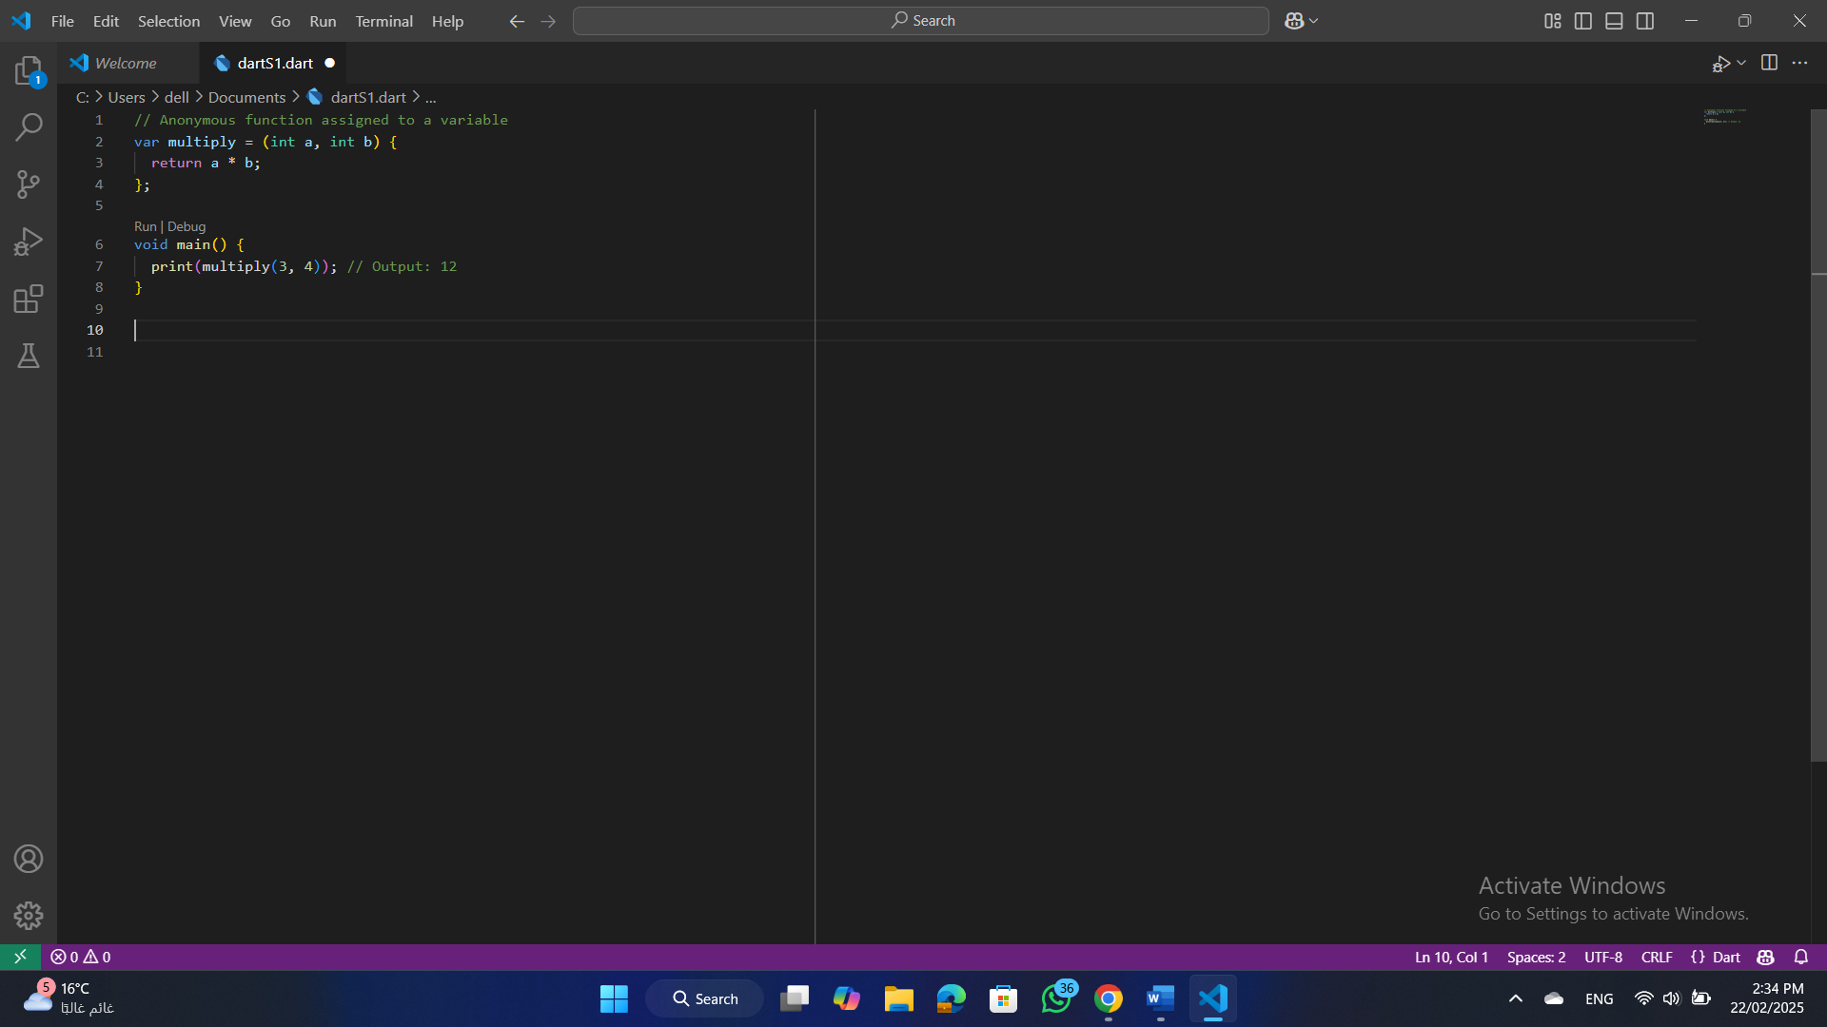
Anonymous Function
Explanation:
We assigned an unnamed function to the variable multiply.
It takes two parameters and returns their product.
We call it like a regular function: multiply(3, 4).
S25' Training Sessions

Slide 24
Types of Errors
Syntax Errors:
Occur due to incorrect syntax.
Example: Missing semicolon.
Fix: Correct the syntax.
S25' Training Sessions
Runtime Errors:
Occur during program execution.
Example: Division by zero.
Fix: Add validation or exception handling.

Slide 25
Types of Errors
Logical Errors:
Incorrect program logic leading to wrong results.
Example: Using + instead of -.
Fix: Review and correct the logic.
S25' Training Sessions

Slide 26
Error Handling
try-catch-finally:
try: Wraps code that might throw an exception.
catch: Catches and handles the exception.
finally: Executes regardless of an error occurring.
S25' Training Sessions

Slide 27
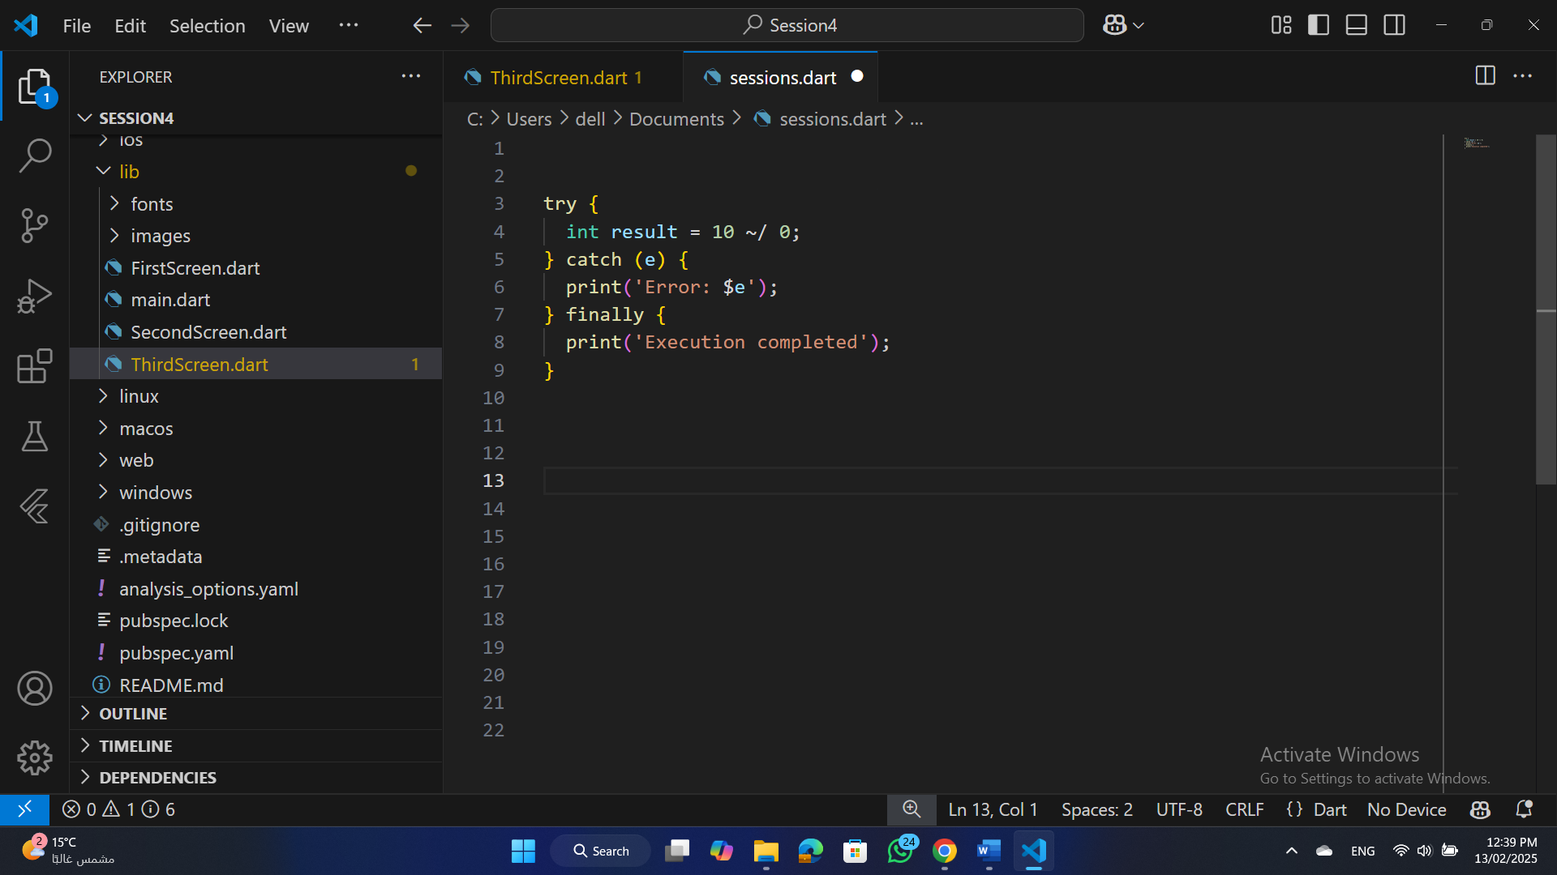
Error Handling
S25' Training Sessions
Note:
For the best implementation, use try-catch for handling user and platform faults; otherwise, use if-else statements.

Slide 28
Exercise
Write a function calculateDeliveryCost that calculates the delivery cost based on:
Required parameters:
weight (kg)
distance (km)
Optional parameters:
isExpress (default: false) → Increases cost by 20% if true.
discount (optional) → Reduces cost by the given percentage.
Cost Calculation:
cost=(weight×5)+(distance×2)
If express delivery is selected, increase cost by 20%.
If a discount is given, reduce cost accordingly.
S25' Training Sessions

Slide 29
Task
S25' Training Sessions
Build a simple calculator program that supports basic operations (addition, subtraction, multiplication, division).

Slide 30

tHANK YOU
SEE YOU NEXT TIME
S25' Training Sessions

